Slide 1
WP6 Big Data analysis and analytics
Leader: CERTH
Partners: ENG, EXPSYS, SYSTRAN, TIU-JADS
Kick-off Meeting
Rome, 29-30 May 2018

Slide 2
Outline
Objectives of the WP
Contact persons
Timing with tasks and deliverables
Brief description of the tasks
Plan for next 6 months
Potential risks & Open issues

Slide 3
Objectives of the WP
Μanipulate, analyse and semantically organize multimedia content acquired from Surface/Deep Web, Dark Nets, Social media and other online sources
multilingual text analysis for processing textual resources
semantically analyse the visual content (image, video)
multilingual translation and speech-to-text services for effectively processing the audio stream
develop a visual indexing infrastructure for enabling time efficient search and retrieval in the large-scale

Slide 4
Contact persons
WP6 Leader: CERTH
Apostolos Axenopoulos – axenop@iti.gr (main contact person)
Georgios Papadopoulos – papad@iti.gr
Contact persons can change during the project duration

Slide 5
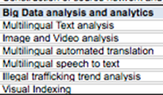

Timing with tasks and deliverables
Task 6.1 – Multilingual Text analysis (M4-M30)
Task 6.2 – Image and Video analysis (M4-M30)
Task 6.3 – Multilingual automated translation (M4-M30)
Task 6.4 – Multilingual speech to text (M4-M30)
Task 6.5 – Illegal trafficking trend analysis (M4-M30)
Task 6.6 – Visual Indexing (M4-M30)

Slide 6
Timing with tasks and deliverables
D6.1 – Text Analysis services [M30] (Internal release [M15])
D6.2 – Image and Video Analysis services and Indexing [M30] (Internal release [M15])
D6.3 – Multilingual automated translation services [M30] (Internal release [M15])
D6.4 – Multilingual speech to text services [M30] (Internal release [M15])
D6.5 – Illegal trafficking trend analysis services [M30] (Internal release [M15])

Slide 7
Task 6.1 – Multilingual Text analysis (M4-M30)
Description – This task will be focused on designing and evolving an avant-garde semantic based text analytics engine for automatic content categorization and entities extraction.
Objectives – Design and develop service that enable the analysis of the text acquired from Surface/Deep Web, Dark Nets, Social media and other online sources, transforming content into usable information
Approach – Based on LEAs requirements, this will be focused on adapting current algorithms that will be enriched with capabilities to extract advanced information, like temporal references and relationships among the extracted entities.
Starting point (existing methods, algorithms, applications, data archives, etc.) – Algorithms developed in previous projects and Cogito® support for identification of classic standard entities (People, Organizations and Places)
Involved partners – Leader: EXPSYS; Participants: ENG
Deliverables – D6.1 [M30]

Slide 8
Task 6.2 – Image and Video analysis (M4-M30)
Description: extract relevant information from visual content (images, videos) available online (Web, Deep/Dark web, social media) and offline (LEA databases) resources.
Objectives: locate-identify real-world objects, high-level semantic entities and semantic events, included in the visual medium.
Approach: Research and development of novel Deep Learning architectures to automatically detect potentially interesting pieces of information or evidence (objects, concepts and events)
Starting point (existing methods, algorithms, applications, data archives, etc.) –
Object
Meta-architectures: Faster R-CNN, SSD, Retina-Net
Feature extractors: Mobilenet v2, NasNet, FPN, Squeeze and Excitation Networks
Concept:
Feature extractors: Inception ResNet v2, Inception v4, NasNet, AlexNet, VGG16, DenseNet
Event detection:
Feature extractors: 2-stream (motion+appearance) networks
Architecture: LSTM networks for modelling events using multi-modal features
S. Thermos, G. T. Papadopoulos, P. Daras, G. Potamianos, "Deep Affordance-grounded Sensorimotor Object Recognition", IEEE Conference on Computer Vision and Pattern Recognition (CVPR 2017), Honolulu, Hawaii, USA, July 2017.
Involved partners – Leader: CERTH
Deliverables – D6.2 [M15 (internal), M30]

Slide 9
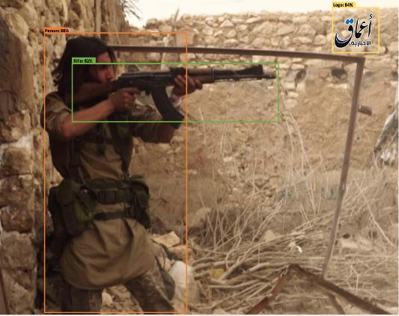
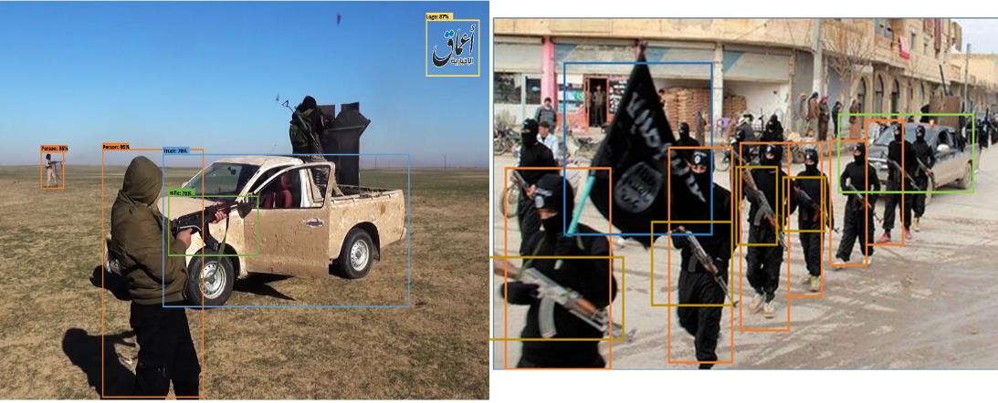
Object detection results

Slide 10
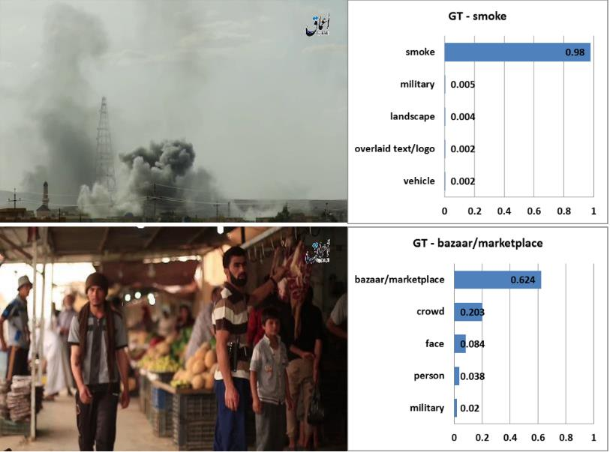
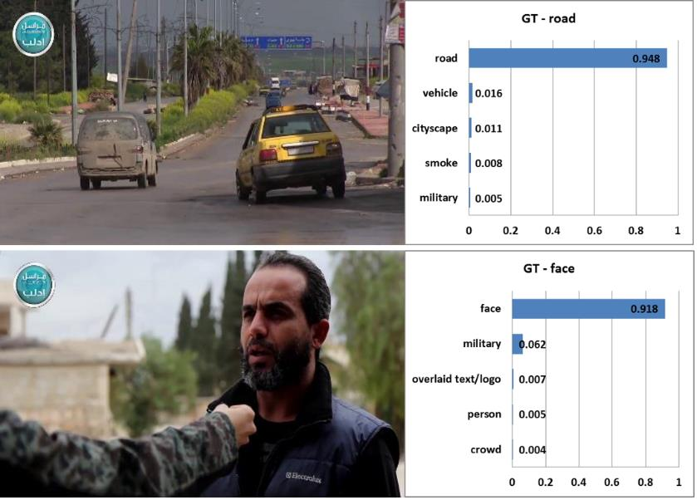
Concept detection results

Slide 11
Task 6.3 – Multilingual automated translation (M4-M30)
Description – SYSTRAN Pure Neural® APIs will support the linguistic coverage in 140+ language combinations
Objectives – Add Value to ANITA analytics platform with large linguistic coverage
Approach – Integrate SYSTRAN Pure Neural® APIs (REST) in the Data Analytics in 140+ language combinations
Starting point (existing methods, algorithms, applications, data archives, etc.) – Using OpenNMT technological framework and standard developed with Harvard nlpgroup SYSTRAN puts at the disposal of ANITA the generic Pure Neural® translation models as well as the APIs utilized for NLP.
Involved partners – Leader: SYSTRAN
Deliverables –
Access to SYSTRAN Pure Neural® Server
Access to Generic Machine Translation Models
Sample codes for Machine Translation and NLP
Domain-specific neural machine translation models generation

Slide 12
Task 6.4 – Multilingual speech to text (M4-M30)
Description – SYSTRAN Pure Neural® APIs will support the Multilingual speech to text linguistic coverage in 38 languages
Objectives – Add Value to ANITA analytics platform with Multilingual Speech to Text recognition feature
Approach – Integrate SYSTRAN Pure Neural® APIs (REST) for speech to text recognition embedding natively partner technologies
Starting point (existing methods, algorithms, applications, data archives, etc.) – Using OpenNMT technological framework and standard developed with Harvard nlpgroup SYSTRAN puts at the disposal of ANITA the generic Pure Neural® translation models as well as the APIs utilized for speech to text recognition.
Involved partners – Leader: SYSTRAN
Deliverables –
Access to SYSTRAN Pure Neural® Server
Access to Generic Speech to Text Recognition and Machine Translation Models
Domain-specific Speech to Text Recognition and Machine Translation Models

Slide 13
Task 6.5 – Illegal trafficking trend analysis (M4-M30)
Description – Cyberthreat Analysis Tool; Proof-of-concept: Data-Intensive Web-Crawling Social/Organizational Graph Mining & Analysis Tool + Statistics;
Objectives – Tool Prototype (M12), Testing (M18) and Evaluation (M30)
Approach – Design Science + Explorative Prototyping + Action Research;
Starting point (existing methods, algorithms, applications, data archives, etc.):
WebHose.io [Closed-Source]
DedSecInside/TorBoT [Open-Source]
ACHE [Open-Source]
CERTH’s existing depthRank and Evolve2Vec methods are available
CERTH is planning to work on Graph Convolutional Network topologies for node classification and semi-supervised learning approaches
Involved partners – Leader: TIU-JADS; Participants: CERTH
Deliverables – D6.5 [M30] - “Illegal trafficking trend analysis services”;

Slide 14
Task 6.5 – Illegal trafficking trend analysis (M4-M30)
Cyberthreat Analysis Tool
What
Social/Organizational Graph Mining & Analysis Tool
Statistics
Investigation Support Data
Rapid-Response Data
Illegal Activity Level
Patterns
Ring-Leadership Motifs
Key-Node Analysis
User Behavior
Buying/Transaction Habits
Starting point (existing methods, algorithms, applications, data archives, etc.):
Proof-of-concept: Data-Intensive Web-Crawling

Slide 15
Task 6.5 – Illegal trafficking trend analysis (M4-M30)
Baselines
Closed-source
WebHose.io
RESTful API
Starting point (existing methods, algorithms, applications, data archives, etc.):
DedSecInside/TorBoT
ACHE

Slide 16
Task 6.6 – Visual Indexing (M4-M30)
Description:
The Visual indexing task aims to compress the visual information in order to make similarity retrieval task faster without sacrificing the accuracy.
Objectives:
Reduce computational resources
RAM usage
disk space requirements
CPU computational cost
Re-project visual content into Hamming space

Slide 17
Task 6.6 – Visual Indexing (M4-M30)
Prior work
Incorporation of semantic segmentation information in deep hashing techniques for image retrieval.
Local-level information is incorporated in the form of image segmentation masks in order to generate more discriminant hash codes
Existing methods
Lin, K., Yang, H. F., Hsiao, J. H., & Chen, C. S. (2015, June). Deep learning of binary hash codes for fast image retrieval. In Computer Vision and Pattern Recognition Workshops (CVPRW), 2015 IEEE Conference on (pp. 27-35). IEEE.
Yang, H. F., Lin, K., & Chen, C. S. (2018). Supervised learning of semantics-preserving hash via deep convolutional neural networks. IEEE transactions on pattern analysis and machine intelligence, 40(2), 437-451.
Involved partners – Leader: CERTH
Gkountakos, K., Semertzidis, T., Papadopoulos, G. T., & Daras, P. (2017, June). Incorporation of semantic segmentation information in deep hashing techniques for image retrieval. In Engineering, Technology and Innovation (ICE/ITMC), 2017 International Conference on (pp. 632-638). IEEE.

Slide 18








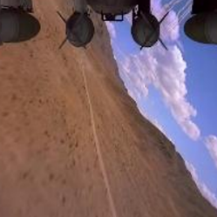
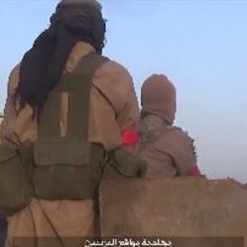

Task 6.6 – Visual Indexing (M4-M30)
Concept:
Gun/Riffle
Ranked list of retrieved images
1
2
3
4
5
1
2
3
4
5
Query Image
6
7
8
9
10
6
7
8
9
10

Slide 19
Plan for next 3 months
TBC

Slide 20
Potential risks & Open issues
Risk | Mitigation plan
+++ | +++
. | .
. | .

Slide 21
WP6 - Big Data analysis and analytics
Thank you for your attention

